Slide 1
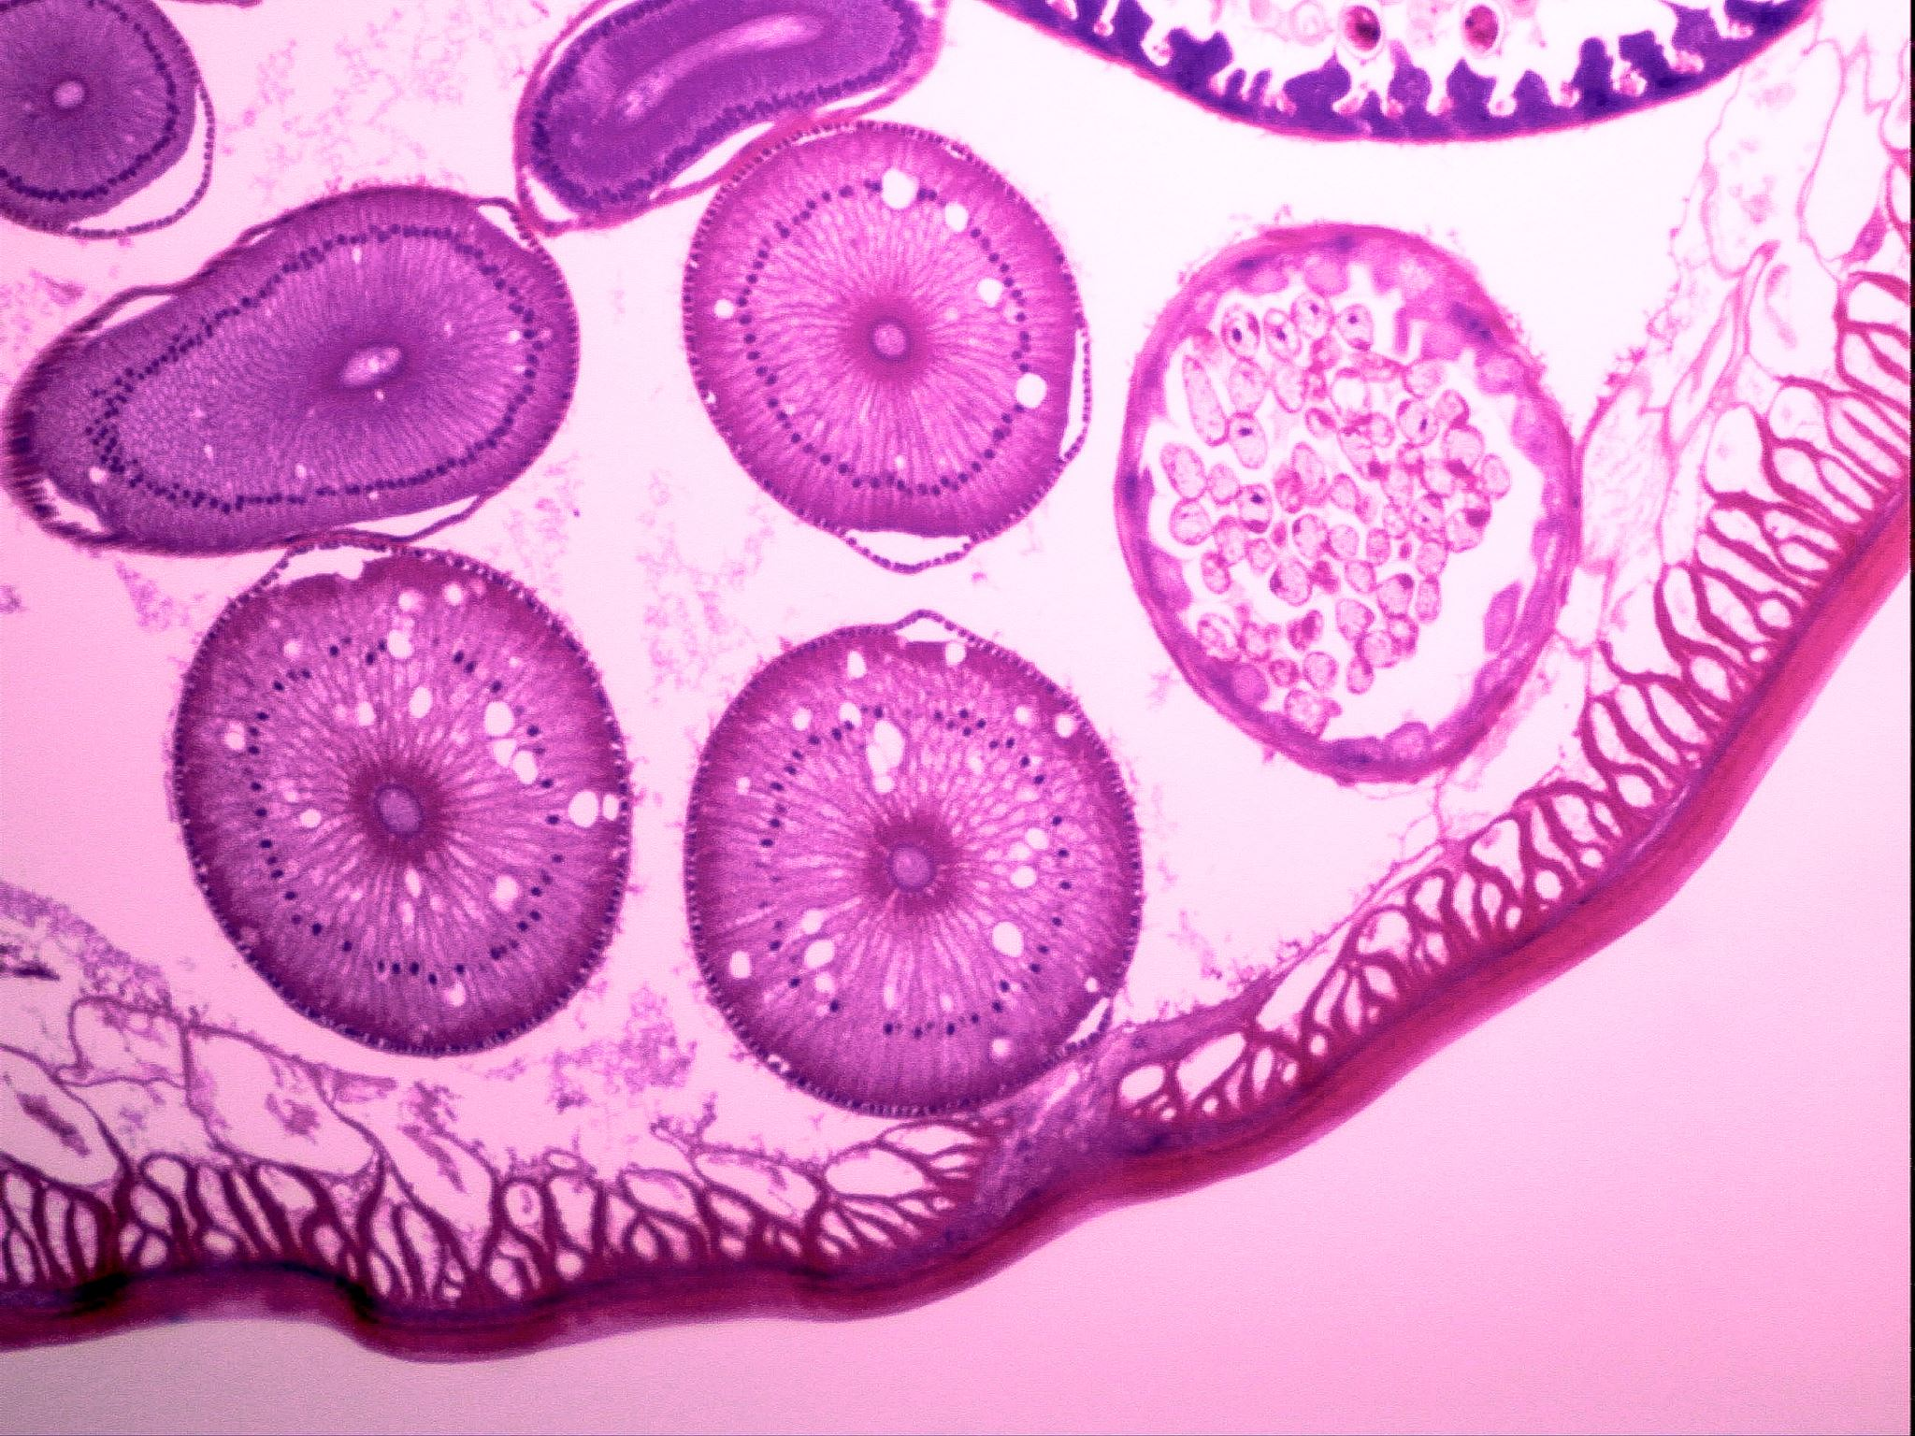
ASCITES HEPATIC
BY ALAN SANTOS
11/20/2023

Slide 2

DEFINITON:
"Ascites hepatic is the accumulation of fluid in the peritoneal cavity caused by liver disease. It is the most common complication of cirrhosis, which is a chronic liver disease that causes scarring and damage to the liver. Ascites hepatic can also be caused by other liver diseases, such as hepatitis B, hepatitis C, and alcoholic liver disease. "by
National Library of Medicine (2017)

Slide 3

Statistics on ascites hepatic in the US:
Prevalence: 16% in patients with cirrhosis
Mortality: 15% in a year to 44% in 5 years
Risk factors: Cirrhosis, alcohol abuse, hepatitis B, hepatitis C, alcoholic liver disease, heart disease, kidney disease, cancer
Symptoms: Abdominal swelling, weight gain, shortness of breath, difficulty sleeping, abdominal pain
Complications: Spontaneous bacterial peritonitis, hepatorenal syndrome, malnutrition, muscle wasting

Slide 4
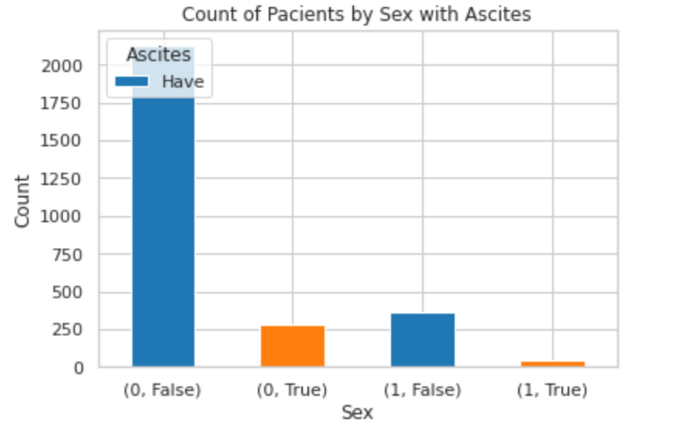
PREVALENCE OF ASCITES IN PATIENCES WITH HEPATATIES :
(0, False) - Male patients with Hepatitis without Ascites
(0, True) - Female patients with Hepatitis without Ascites
(1, False) - Male patients with Hepatitis with Ascites
(1, True) - Female patients with Hepatitis with Ascites

Slide 5
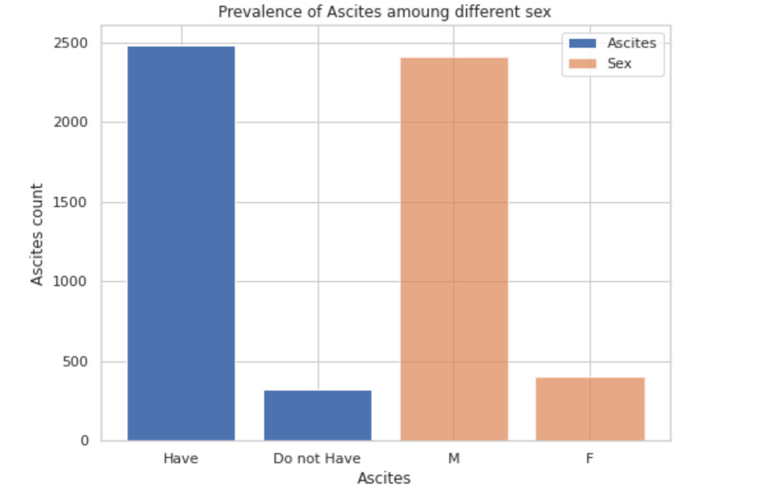
PREVALENCE OF ASCITES BY GENDER:

Slide 6
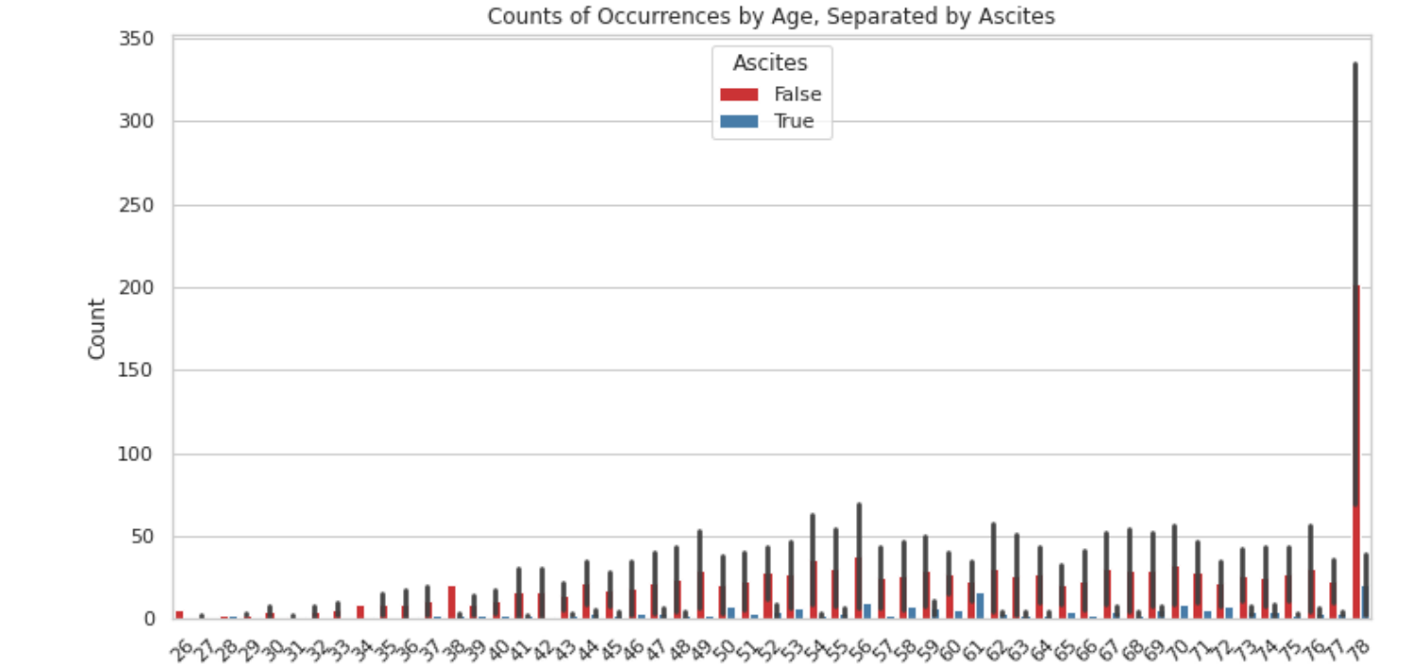
OCCURRENCE OF ASCITES BY AGE:

Slide 7
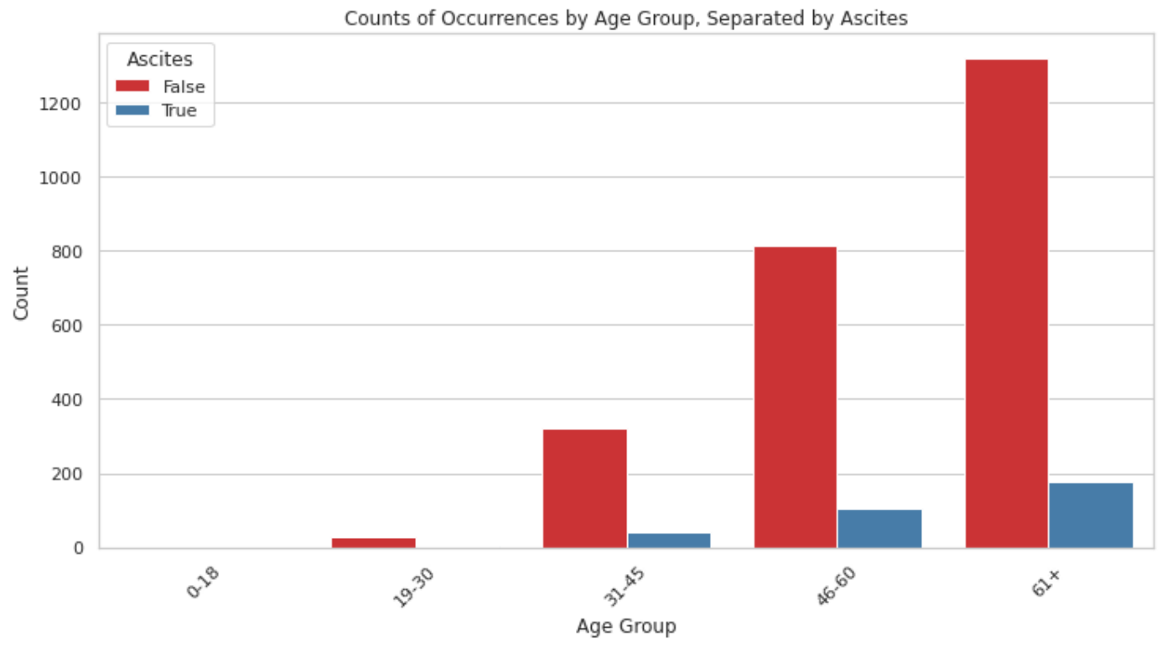
OCCURRENCE OF ASCITES BY AGE-GROUP:

Slide 8
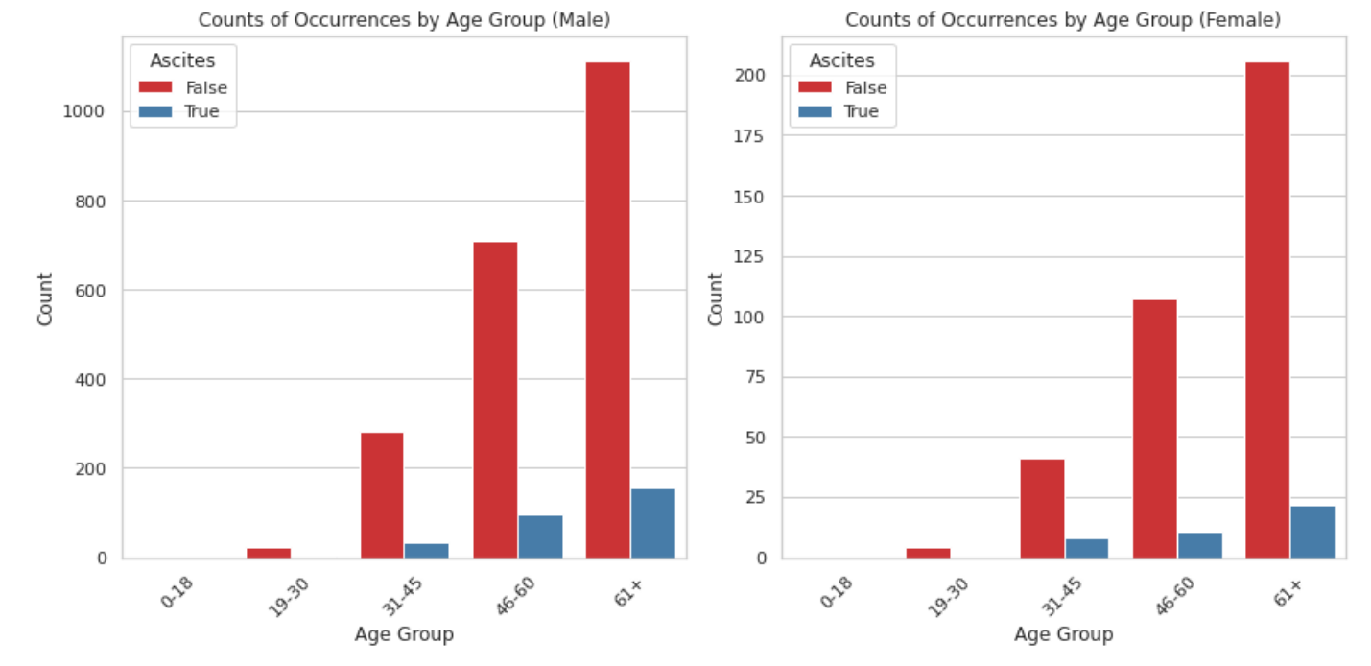
OCCURRENCE OF ASCITES BY AGE-GROUP AND GENDER:

Slide 9
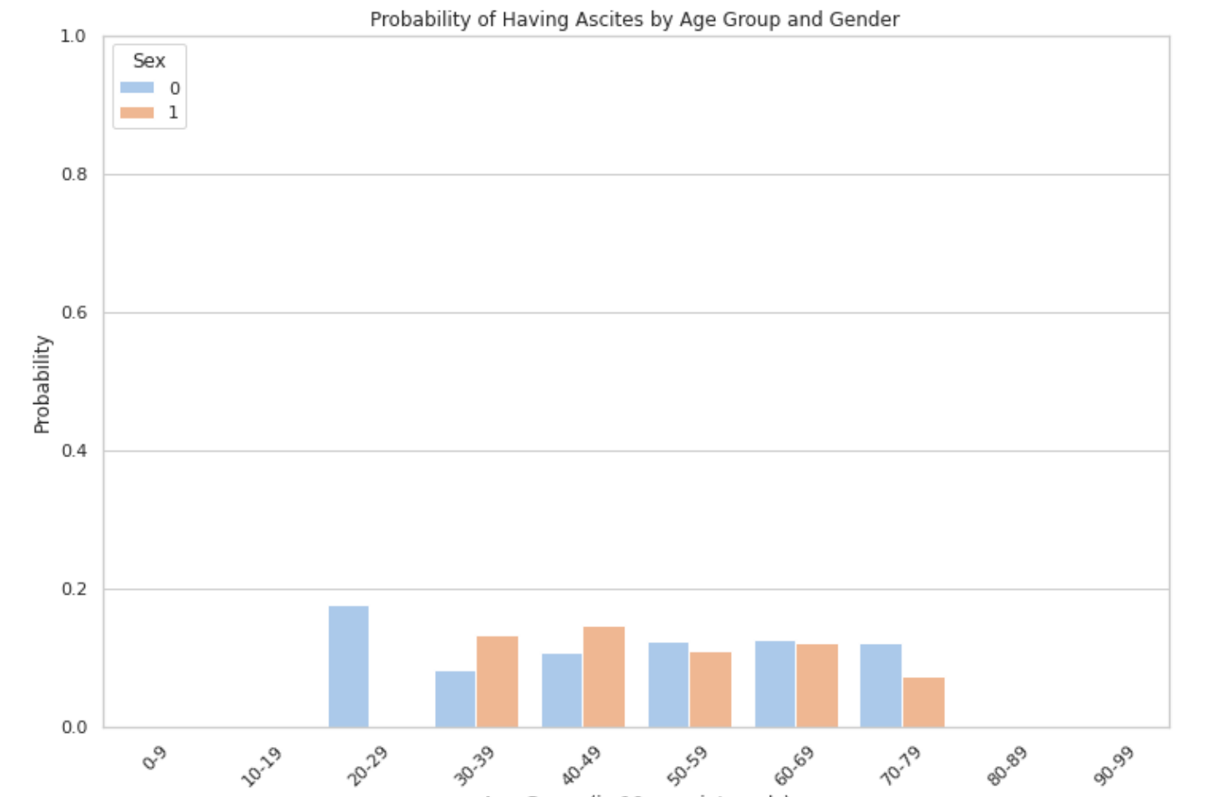
PROBABILITY OF HAVING ASCITES BY AGE-GROUP AND GENDER:

Slide 10
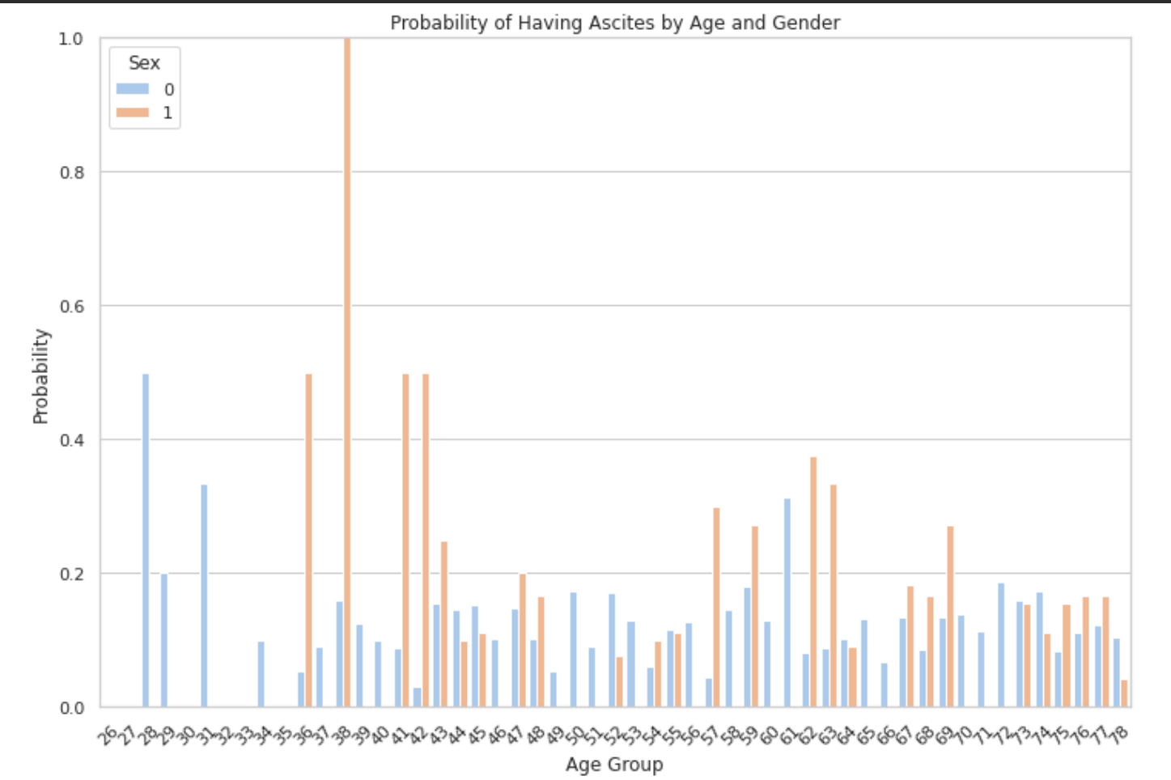
PROBABILITY OF HAVING ASCITES BY AGE AND GENDER:

Slide 11
REFERENCE
American College of Gastroenterology. Ascites: a common problem in people with cirrhosis (https://gi.org/topics/ascites/). Accessed 6/11/2021.
Cancer Research UK. About fluid in the abdomen (https://www.cancerresearchuk.org/about-cancer/coping/physically/fluid-abdomen-ascites/about). Accessed 6/11/2021.
Radiological Society of North America. Transjugular Intrahepatic Portosystemic Shunt (TIPS) (https://www.radiologyinfo.org/en/info/tips). Accessed 6/11/2021.
U.S. Department of Veterans Affairs. Ascites (Fluid in the belly) (https://www.hepatitis.va.gov/cirrhosis/patient/ascites.asp). Accessed 6/11/2021.
Ascites". National Library of Medicine. Retrieved 14 December 2017.
Ascites | Definition of Ascites by Lexico". Lexico Dictionaries | English. Archived from the original on October 25, 2019. Retrieved 26 October 2019.
Alter MJ, Kruszon-Moran D, Nainan OV, McQuillan GM, Gao F, Moyer LA, et al. The prevalence of hepatitis C virus infection in the United States, 1988 through 1994. New England Journal of Medicine. 1999;341:556-62.

Slide 12
REFERENCE:
Smith BD, Patel N, Beckett GA, Ward JW. Hepatitis C virus antibody prevalence, correlates and predictors among persons born from 1945 through 1965, United States, 1999-2008 [Abstract]. Hepatology. 2011;54(4, Suppl):554A-5A.
6 U.S. Centers for Disease Control and Prevention, 2017. Op. cit.
7 U.S. Centers for Disease Control and Prevention. Surveillance for Viral Hepatitis - United States, 2015. Updated June 19, 2017. www.cdc.gov/hepatitis/statistics/2015surveillance/commentary.htm. Accessed September 15, 2017.
8 Zibbell JE, Iqbal K, Patel RC, Suryaprasad A, Sanders KJ, Moore-Moravian L, et al. Increases in hepatitis C virus infection related to injection drug use among persons aged <30 years-Kentucky, Tennessee, Virginia, and West Virginia, 2006-2012. Morbidity and Mortality Weekly Report. 2015;64(17):453-8.
9 U.S. Centers for Disease Control and Prevention, 2017. Op. cit.
10 Louie KS, St Laurent S, Forssen UM, Mundy LM, Pimenta JM. The high comorbidity burden of the hepatitis C virus infected population in the United States. BMC Infectious Diseases. 2012;12:86.
11 U.S. Centers for Disease Control and Prevention. Hepatitis C FAQs for Health Professionals. Updated January 27, 2017. www.cdc.gov/hepatitis/hcv/hcvfaq.htm. Accessed September 15, 2017.

